Slide 1

Credit Risk Approval
Eric Scoggins
Megan Jones

Slide 2


Agenda
Goals of Credit Risk Recommendation System
Data Overview w/ Exploratory Insights
Traditional Machine Learning Model Overviews
Azure Automated Machine Learning
Final Model Recommendation
Next Steps
Notes:
Eric
Welcome to our proposal for creating a better system for deciding which customers might be a credit risk for our company.
Our Agenda Today will be to walk you through the goals we hope this process will achieve, explore the data we have available for this process and provide some insights, discuss some traditional machine learning models we’ve tested as well as detail Azures Automated Machine Learning algorithm.
Finally, we will provide our recommendation and next steps.

Slide 3
Goals of Credit Risk Recommendation System
Reduce Risk for Stakeholders
Identify Key Factors for High-Risk Clients
Streamline Implementation with AutoML
Provide an Automated Solution to Credit Approval
Notes:
Eric
The goals of this project are to reduce the risks for stakeholders that come with investing in people with poor credit, we want to identify key factors that point us to high-risk clients, we would like to provide an automated credit approval solution to remove natural human bias from our decision making, and finally discuss the option of streamlining our implementation by using Auto ML.

Slide 4
Data Attributes
1,000 Observations
7 Categorical Variables
4 Numerical Values
Response = Good Credit
19 Binary Variables
Variable Groups
Financial History
Credit Information
Customer Information
Purpose
Notes:
Megan
To provide value to our stakeholders we want to start with a preliminary overview of our data.
…. [Review Metrics]
Most of our variables can be allocated to groups described as Financial History, Credit Information, Customer Information, and Purpose.
While these are now tangible data points

Slide 5
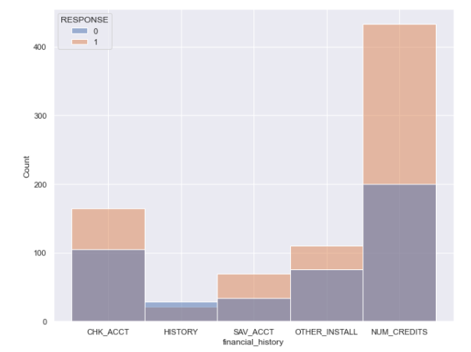
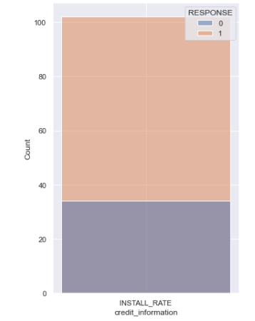
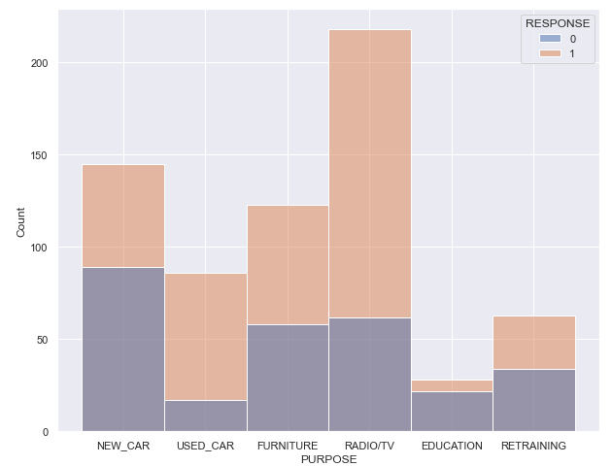
Categorical Variables
Notes:
Megan
Here we continue the overview by showing a few of those categorical groups. Due to time restraints we have only included 3 here but have additional charts in the appendix.
Overall we have a higher count of good credit than bad credit with the exception of History.
Installment Rate is the % of disposable income that payments would consume. We take this to mean if an applicant has more available disposable income they are more likely to be flagged as good credit
Other Install is whether that applicant is on another payment plan
[insert insights – read book for variable description]

Slide 6
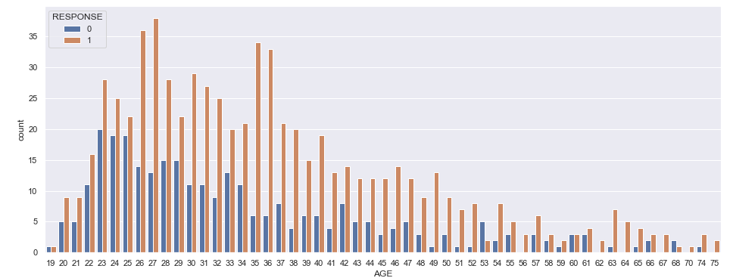
Approval Distribution by Age
0 = Bad Credit
1 = Good Credit
Notes:
Eric
Out of 1000 observations we had 700 customers with good credit and 300 with bad. We can see that are customer ranges with the best total count of good credit are in their mid-20s and mid 30s with the only bad credit being more numerous than good credit at 66.
This data set was very small over all though and a much larger data set may give us a more accurate feel to the actual distribution of credit across the age groups.

Slide 7
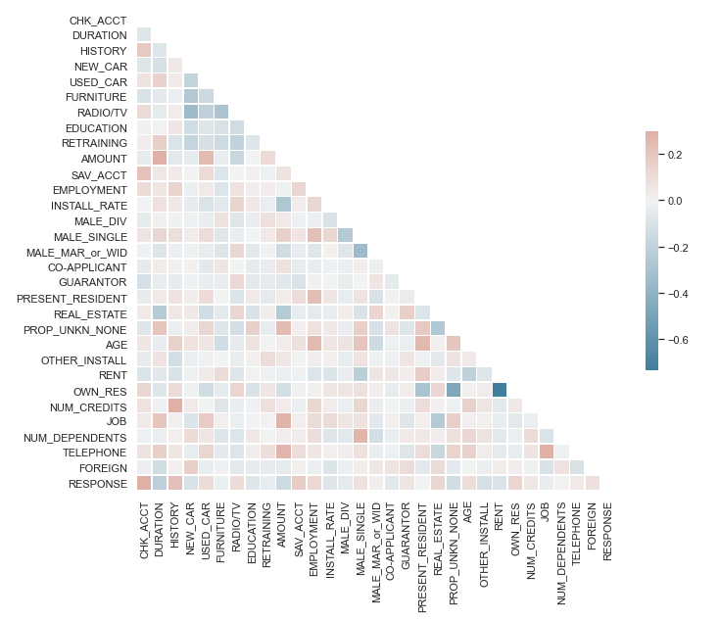
Feature Correlation Analysis
Divorced vs. Single (-)
Amount vs. Duration (+)
Age vs Unknown Property (+)
Radio vs New Car (-)
Notes:
Eric
Correlation lets us know if two variables in our data set are related. Correlation does not imply causality, for example we may be able to extrapolate from our previous slide of good/bad credit by age that the older the client the greater the % of bad credit customers. Though we can use Age as a predictor of a customer’s credit as they are correlated slightly, but we can not say from this data that Age is a causality of bad credit.
correlation is a measure of the degree of dependence between two random variables. In general, the word correlation implies a linear relationship.
Correlation can be a positive phenomenon, as it can make it possible to make predictions on one variable knowing the values ​​of another variable.
As you can see from the model above the darkest square highlights two variables, own and rent residence. Since it’s unusual for someone to both rent and own a place of residence we can see that these two variables have a high negative degree of correlation meaning that applicants who rent are unlikely to own and vice versa.
We can also see other notable positive correlations between Amount and Duration, Male/Single and Number of dependents, and another strong negative correlation between Male/Div and Male/Sing
Knowing these correlations we are able to reduce the variables in our predictive model and create a more accurate model as having variables that are correlated can imbalance the predictive algorithms.

Slide 8
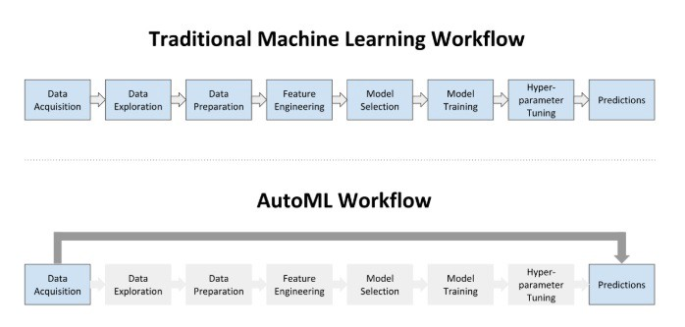
Machine Learning Methods Comparison
Notes:
Megan speak to stages of Traditional ML and high level
At this point we have taken you through some high level exploratory analysis to provide the foundation for the rest of our presentation. Our team developed a solution for the stakeholder request two ways.
Here we can see the traditional method that we have used in prior meetings. As you can see it is a multi-step processes that often leads to rounds of refactoring from our data experts.
Below you have the AutoML method. This is a relatively new method that our team has utilized to streamline results. As shown here we are able to obtain predictions after data acquisition and spend the training time on other activities.
The time saved with AutoML can be seen as a cost saving in terms of labor hours.

Slide 9
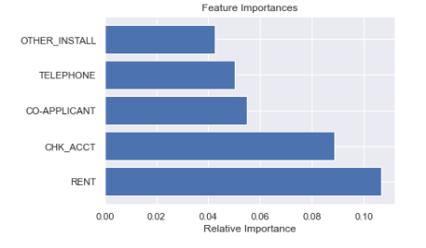



Model Selection Key Considerations
End Use
Available Data
Impact of Error
Notes:
Megan
Now that we have reviewed the process we want to describe some key considerations that were used for our model development.
We did some analysis on feature importance you can see here the top 5 all related in some ways to financial history and customer information.
When deciding to narrow down our variables we considered the following:
End Use: What is critical information for our task. In this end an applicants history would be a good starting point to judge credit behavior patterns.
Additionally
Data Available: If we are to deploy a model what information will we have at the time of application. The features above would be available on the application or credit report.
Finally
Impacts of Incorrect Predictions: Incorrectly labelling an applicant could lead to poor customer experience and potential impact to brand. Conversely there is a financial impact to the business if the wrong applicant is labeled as good credit.
Based on the above we have completed an analysis to determine the most important features for our model. We will discuss in next steps how meetings with stakeholders we can make adjustments before a model is deployed.

Slide 10
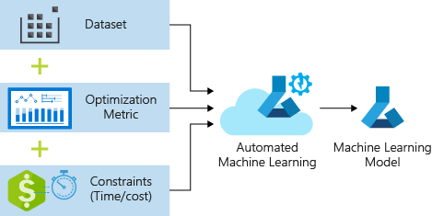
MS Azure Automated Machine Learning
Notes:
Image Source: https://docs.microsoft.com/en-us/azure/machine-learning/tutorial-auto-train-models
Eric speak to Benefits of AutoML and how to customize solutions
This process accepts training data and configuration settings, and automatically iterates through combinations of different feature normalization/standardization methods, models, and hyperparameter settings to arrive at the best model.
Because this whole process is automated it only requires a few configuration settings to begin building/validating the best possible Predictive Model. The savings in time and personnel to setup these classifications is greatly reduced and we are able to test many algorithms in a short amount of time to find the best fit.
For our model we used AzureML with the default configurations. The model took about 1.5 hours to run through and finished before the max time run suggesting that Azure ran through all of the potential models to find the best one.
Reserving 10% of our data set for validation AzureML picked the ‘VotingEnsemble’ Algorithm and came up with a AUC score of .79 which is very good.
We believe we can get this model to be more accurate by tweaking the configuration settings further but for a run that required very little engagement from us it seems to have done very well.

Slide 11
Algorithm Performance Overview & Final Recommendations
Algorithm | Validation
Logistic Regression | 75.5%
Decision Tree | 71.7%
PCA Grid Search | 93.2%
PCA Logistic Regression | 89.9%
Azure Auto ML | 79%
Notes:
Eric –
Surprisingly we can see that our manual processes outperformed our Azure ML example. Though we recommend PCA Grid Search based on it’s high validation score we still believe the time/effort savings from AzureML are too good to ignore though and we also recommend continuing to develop in AzureML (tweaking the current process and creating new ones). This should give our company great flexibility in building models and allow us to do at least preliminary ML classifications at the speed of our business.

Slide 12

Final Recommendation
Time-Sensitive Request
Consistent Processing Techniques
Adapt Platform to Meet Business Needs
Ease of Transition
Cohesive Technology Eco-System
Final Recommendation = MS Azure AutoML
Notes:
Megan
As Eric mentioned we would like to move forward with the cloud-based approach. First I’ll take you through considerations then I will move on to next steps.
Based on the time-sensitive nature of this task its best to offer the consistency of processing techniques as well as the ability to transition to deployment that our partners at MS offer.
Our business already runs on Microsoft Office and folding in Azure would be best to train our people on future focused skills. Here we win on two fronts by providing our people with future focused skills and showing customers we lead from a technology standpoint.

Slide 13
Next Steps
Migrate Data Sources to Azure
Customize Model
Meet w./Stakeholder for Final Model Selection
Deploy Solution
Notes:
Megan
Finally, for if we are to move forward with the automated model we have a few next steps
We will need to migrate data sources to Azure for streamlined end to end model solution.
Based on our findings with additional data we need to customize the model. Encoding variables as needed
We will present updated models to stakeholders for final approval
Then we can have a seamless transition to deploy the model to a suitable application for our end-users.
If the stakeholders determine they want to stick with our manual development and deployment we are happy to answer any questions on what that may look like.

Slide 14
Appendix

Slide 15
Manual Next Steps
Work with IT to connect to Data Sources
Customize Model
Meet w./Stakeholder for Final Model Selection
Work with Deployment Team to Push Application
Determine Efficient Solution for Computing Processes
Notes:
Megan
Finally for if we are to move forward with the automated model we have a few next steps
[explain]
If the stakeholders determine they want to stick with our manual development and deployment we are happy to answer any questions on what that may look like.

Slide 16
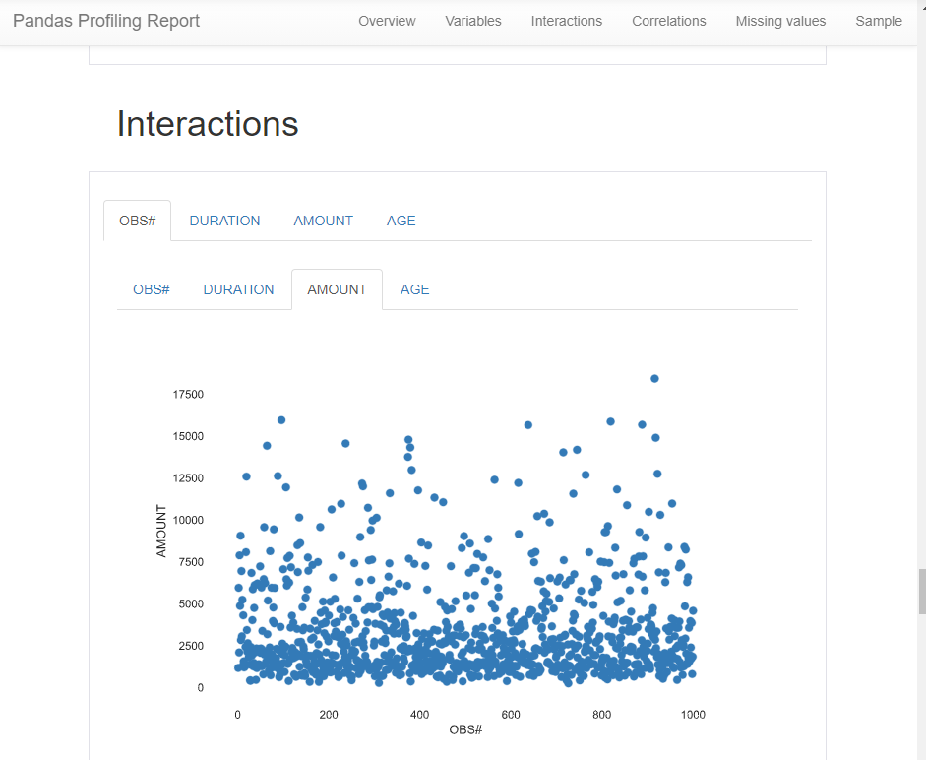
Pandas-Profiling
Great tool for exploratory analysis.
https://pypi.org/project/pandas-profiling/

Slide 17
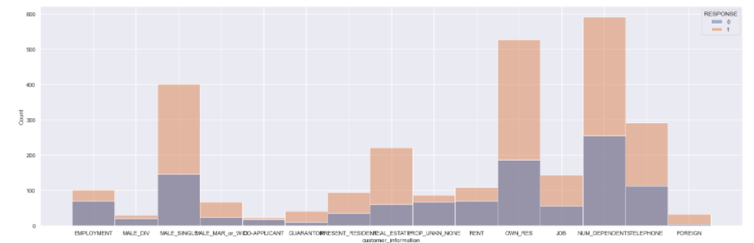
Categorical Variables Continued

Slide 18
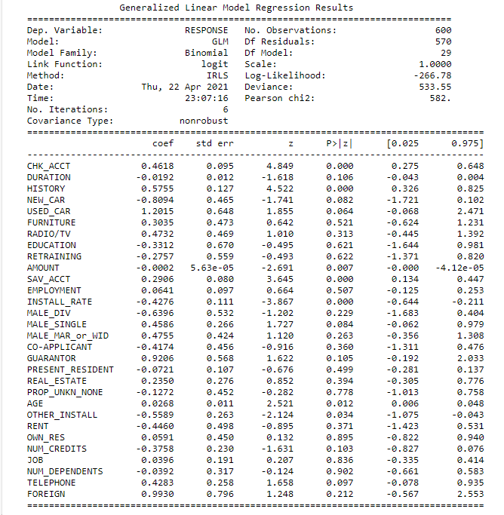
Logistic Regression Formula

Slide 19
Sources
https://docs.microsoft.com/en-us/azure/machine-learning/tutorial-auto-train-models
https://pypi.org/project/pandas-profiling/
https://towardsdatascience.com/feature-preprocessor-in-automated-machine-learning-c3af6f22f015
Note: Research was conducted to determine best practices within the credit industry.

